Slide 1
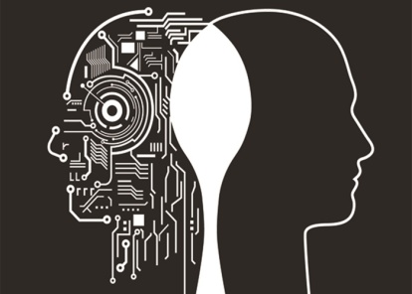
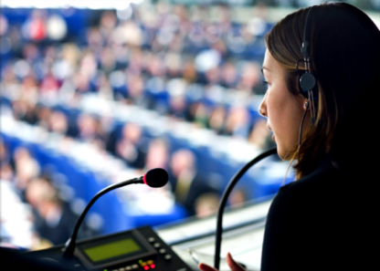
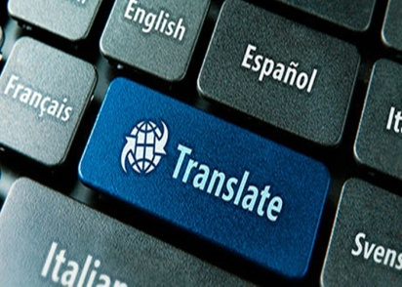
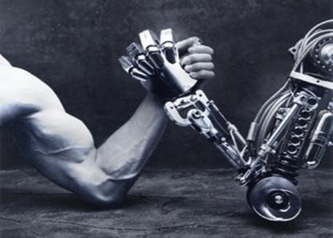
RESEARCH PROJECT
CAN TECHNOLOGY REPLACE HUMAN TRANSLATORS?
Author Sergio Jiménez
Mentor Cristina Zapata
Institute Ausiàs March
Course 2nd Baccalaureate
Academic year 2016-2017

Slide 2
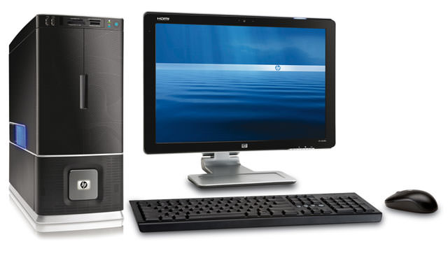
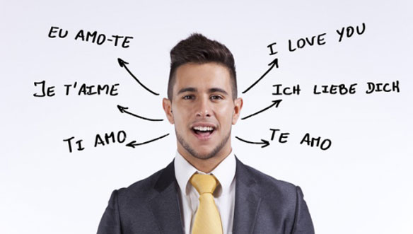
INTRODUCTION AND HYPOTHESIS
What are the differences between Translation and Interpretation?
Are there specific techniques in order to translate?
How is the daily routine of a translator?
Is Technology a real threaten to human translators?
What is the meaning of Transcreation?

Slide 3
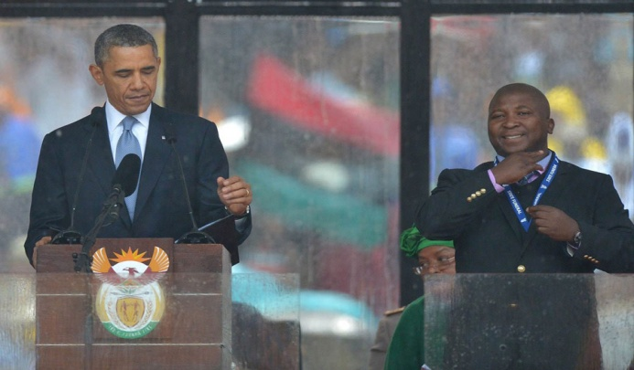
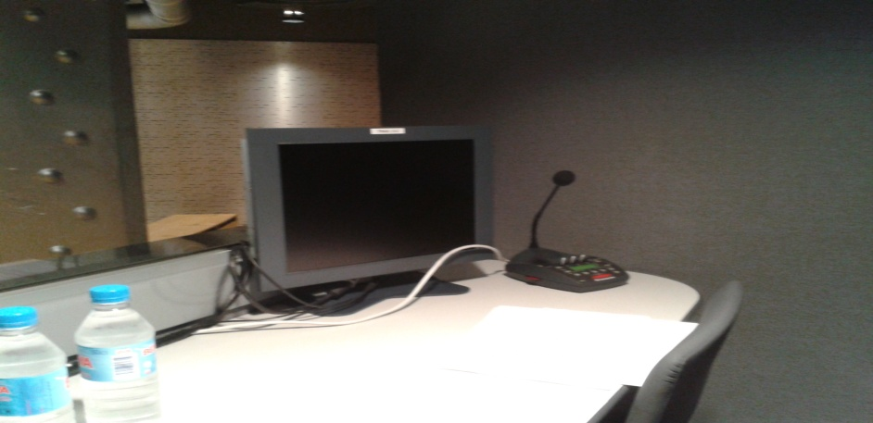
TRANSLATION AND INTERPRETATION
TRANSLATORS
INTERPRETERS

Slide 4
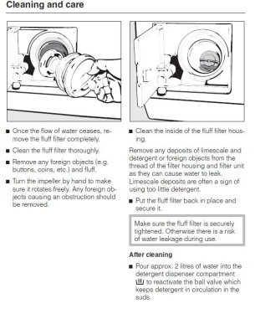
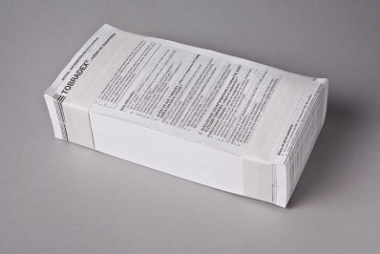
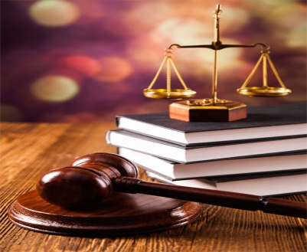
TECHNOLOGY’S ROLE IN TRANSLATION
COMPUTER-ASSISTED TRANSLATION (C.A.T): Technological process used by translators in order to facilitate, improve or speed up their translations.
CAT TOOLS: Grammar checkers, electronic dictionaries, concordancers, full-text search tools, terminology databases…
Scientific texts
Juridical texts
Technical texts

Slide 5
C.A.T’S ADVANTAGES AND DISADVANTAGES
ADVANTAGES
DISADVANTAGES
Energy and time-saving
Efficiency and speed
Less mistakes
Translation memory
Production increase
Difficult to work with
Text uniformity
Post-edition

Slide 6
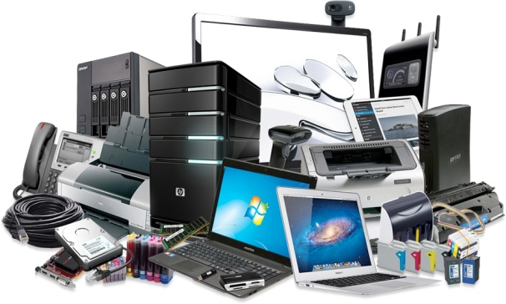
ELEMENTS THAT TECHNOLOGY CANNOT TRANSLATE
Films and literature
Sayings, tongue twisters and puns
Rhyme
Creativity
Humor
Irony
Cultural issues
Machines can’t think, create, imagine nor try to transmit emotions because that’s an exclusive human characteristic.

Slide 7
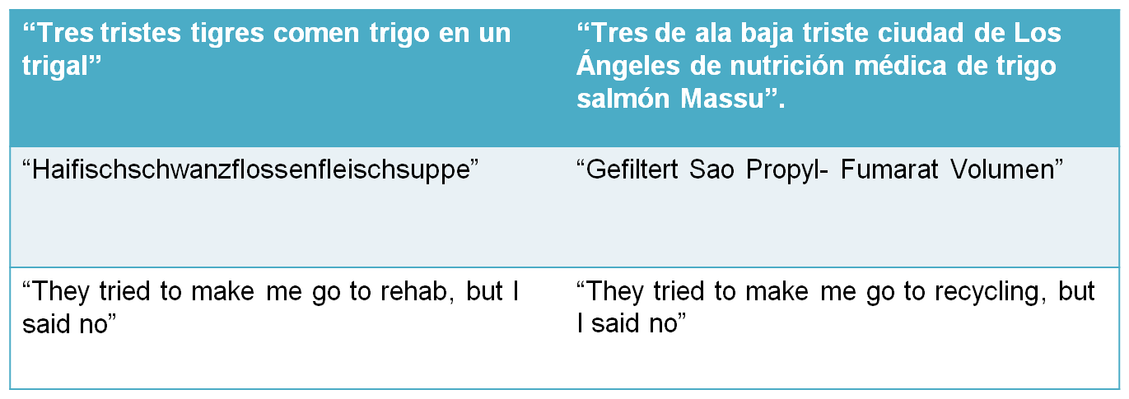
GOOGLE TRANSLATOR

Slide 8
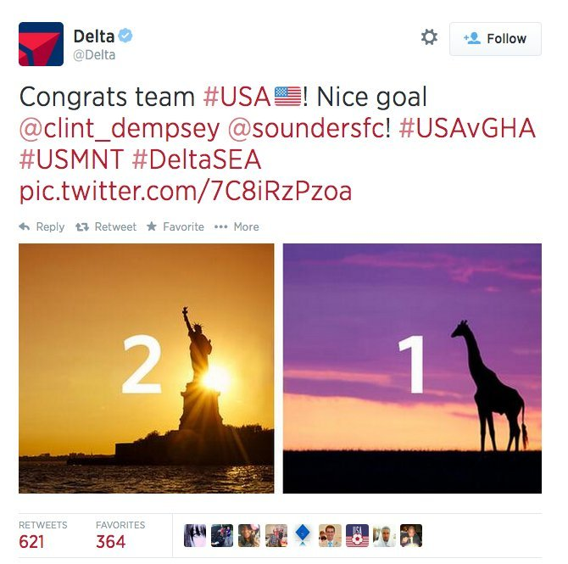
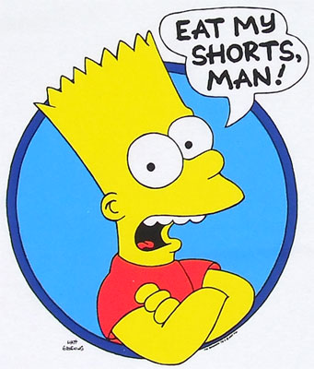
TRANSCREATION
It is the process of adapting a message from one language to another avoiding cultural shock and respecting the other nation’s taboos.
It is mainly used by advertising and marketing professionals.

Slide 9
PRACTICAL PART
PILAR RAMÍREZ TELLO
English and Spanish Translator
Does NOT use CAT tools
Genre: Literature
“The Hunger Games”
“Divergent”
“Percy Jackson’s Greek Gods”
ROSA MARÍA SANZ
English-to-Spanish translator, post-editor, subtitler and interpreter
USES CAT tools
Genre: Medicine, Odontology, Technology, Marketing and Tourism texts

Slide 10
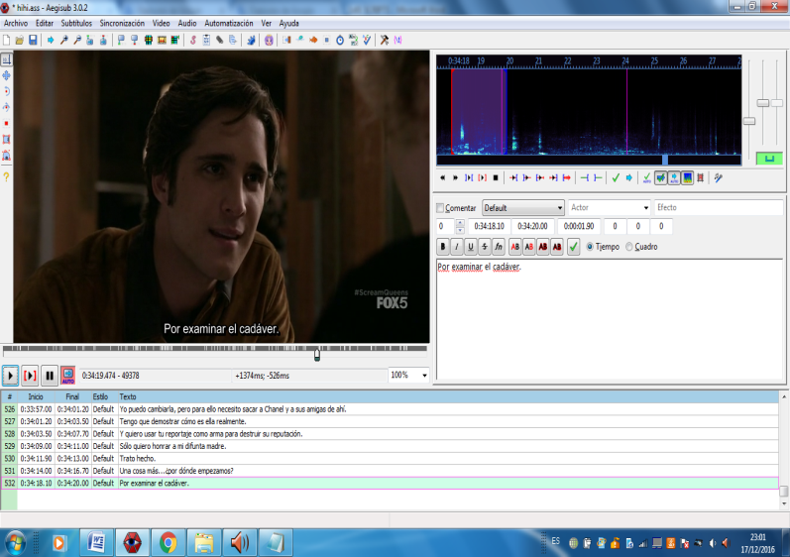
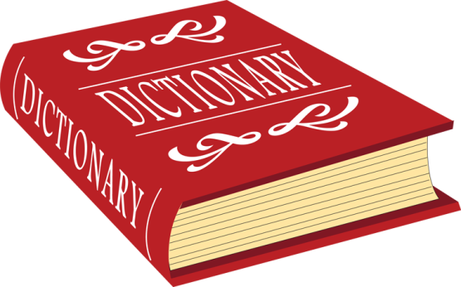
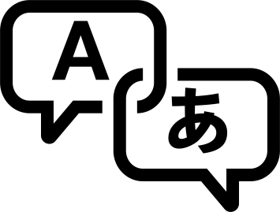
PRACTICAL PART

Slide 11
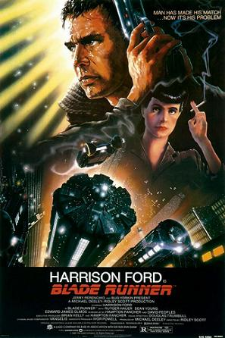
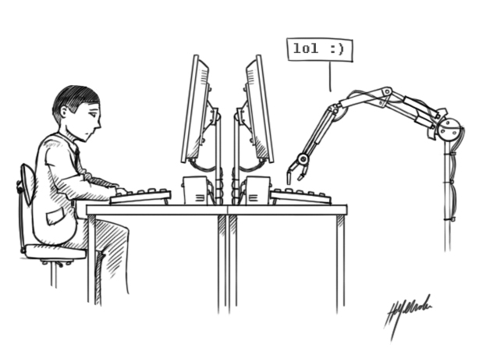
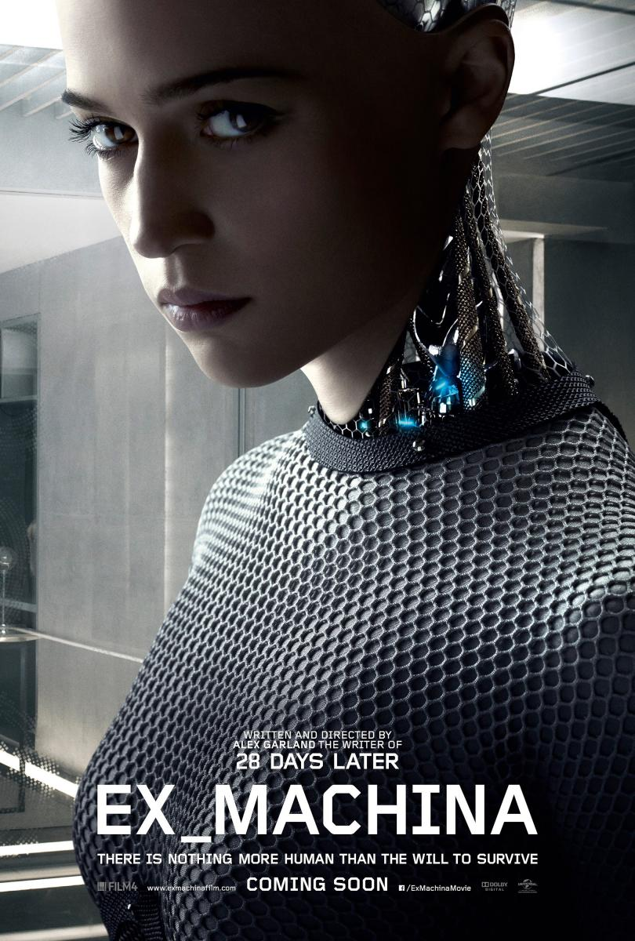
CONTEMPORARY REFERENCES
BLADE RUNNER (1982)
TURING TEST (1950)
EX MACHINA (2015)

Slide 12
CONCLUSIONS
Translation does not follow a uniform pattern
Technological appliances are made by human brains and are under their control
Computers will never have the essence that human beings have and thus their work will always have limits
Transcreation will never be able to be translated by Computer-Assisted Translation or any other technological technique
Speaking a language does not mean you know how to translate it

Slide 13
„Wer fremde Sprachen nicht kennt, weiß nichts von seiner eigenen“
Johann Wolfgang von Goethe

